Slide 1
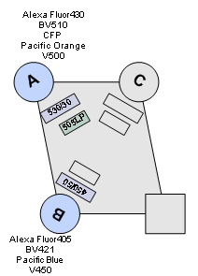
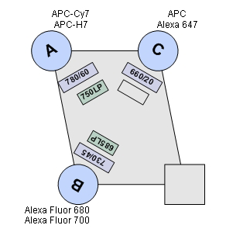
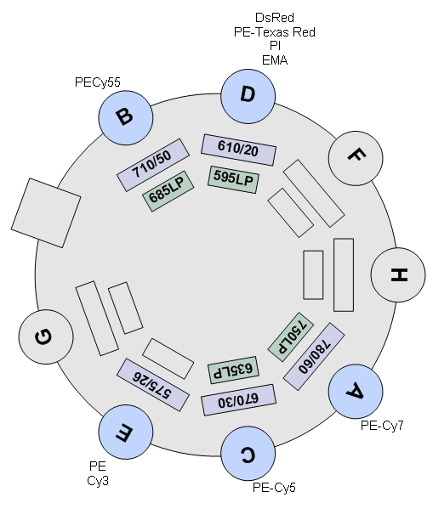
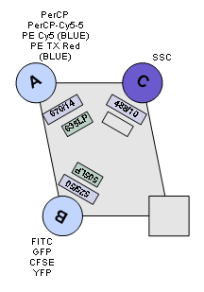
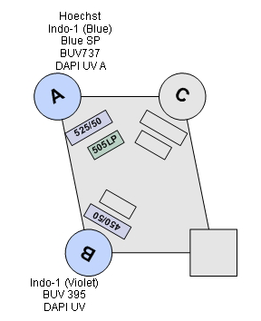
BV605
BV421
Pacific Blue
IMMUN LSRII
C
610/20
450/50
595 LP
Violet
405
Red
640
505 LP
525/50
720/20
BV510
AmCyan
695/40
740/35
Green
532
690LP
Blue
488
UV
355
379/28

