Slide 1
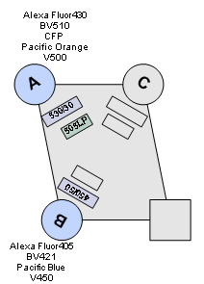
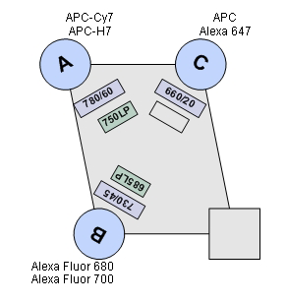
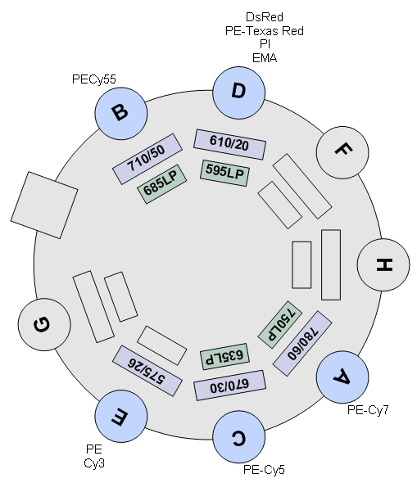
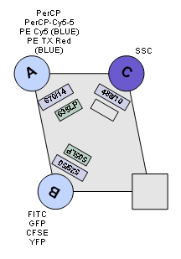
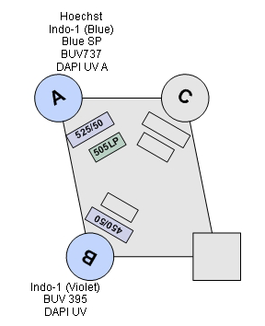
BV605
BV421
Pacific Blue
STI LSRII
C
610/20
450/50
595 LP
Red
640
Violet
405
505 LP
720/20
525/50
BV510
AmCyan
695/40
740/35
Green
532
690LP
Blue
488
UV
355
379/28

