Slide 1

Getting Sorting Sorted
November 2024

Slide 2
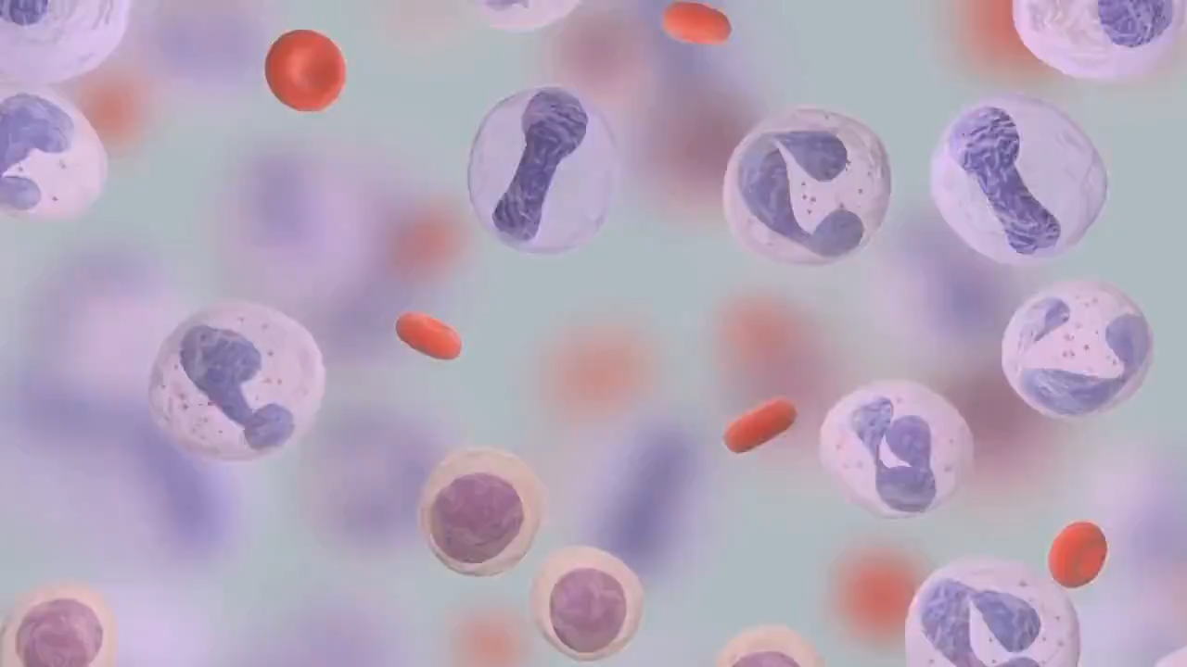
Why are we sorting for you today?
You want to run an assay on your cells of interest, but they’re all mixed together with other cells and debris you don’t want.
Or maybe your transfection was not 100% efficient, and you need to enrich the positive population.
Perhaps you’re trying to start a clonal culture by seeding a single cell of your target cell type into each well of a plate.
Gif taken from educational video by the StarCellBio Project @ MIT
http://star.mit.edu/CellBio/animations/index.html
Full video is available on YouTube

Slide 3
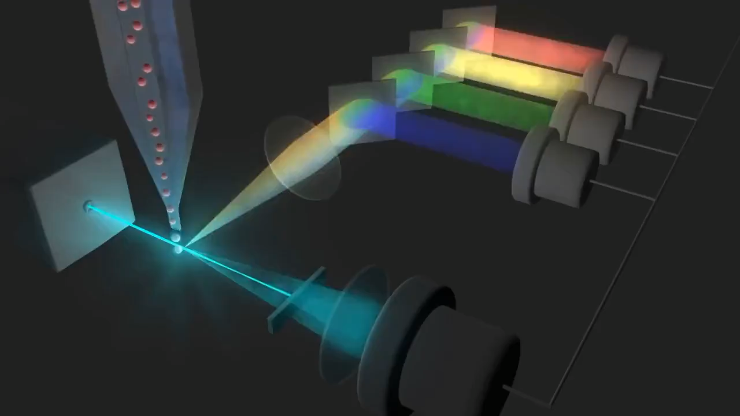
Flow Cytometry Background
First your fluorescently labeled cell mixture is hydrodynamically focused in a laminar flow of sheath fluid.
  I.e., the magic of fluidics lines up the cells in [almost] single file inside a smoothly flowing “sheath” of sterile PBS.
These cells then flow through a series of lasers, which excite the fluorophores on the cells in a frequency/wavelength/color dependent manner.
  This animation shows one such laser with conventional PMTs (a kind of light detector).
Gif taken from educational video by the StarCellBio Project @ MIT
http://star.mit.edu/CellBio/animations/index.html
Full video is available on YouTube

Slide 4
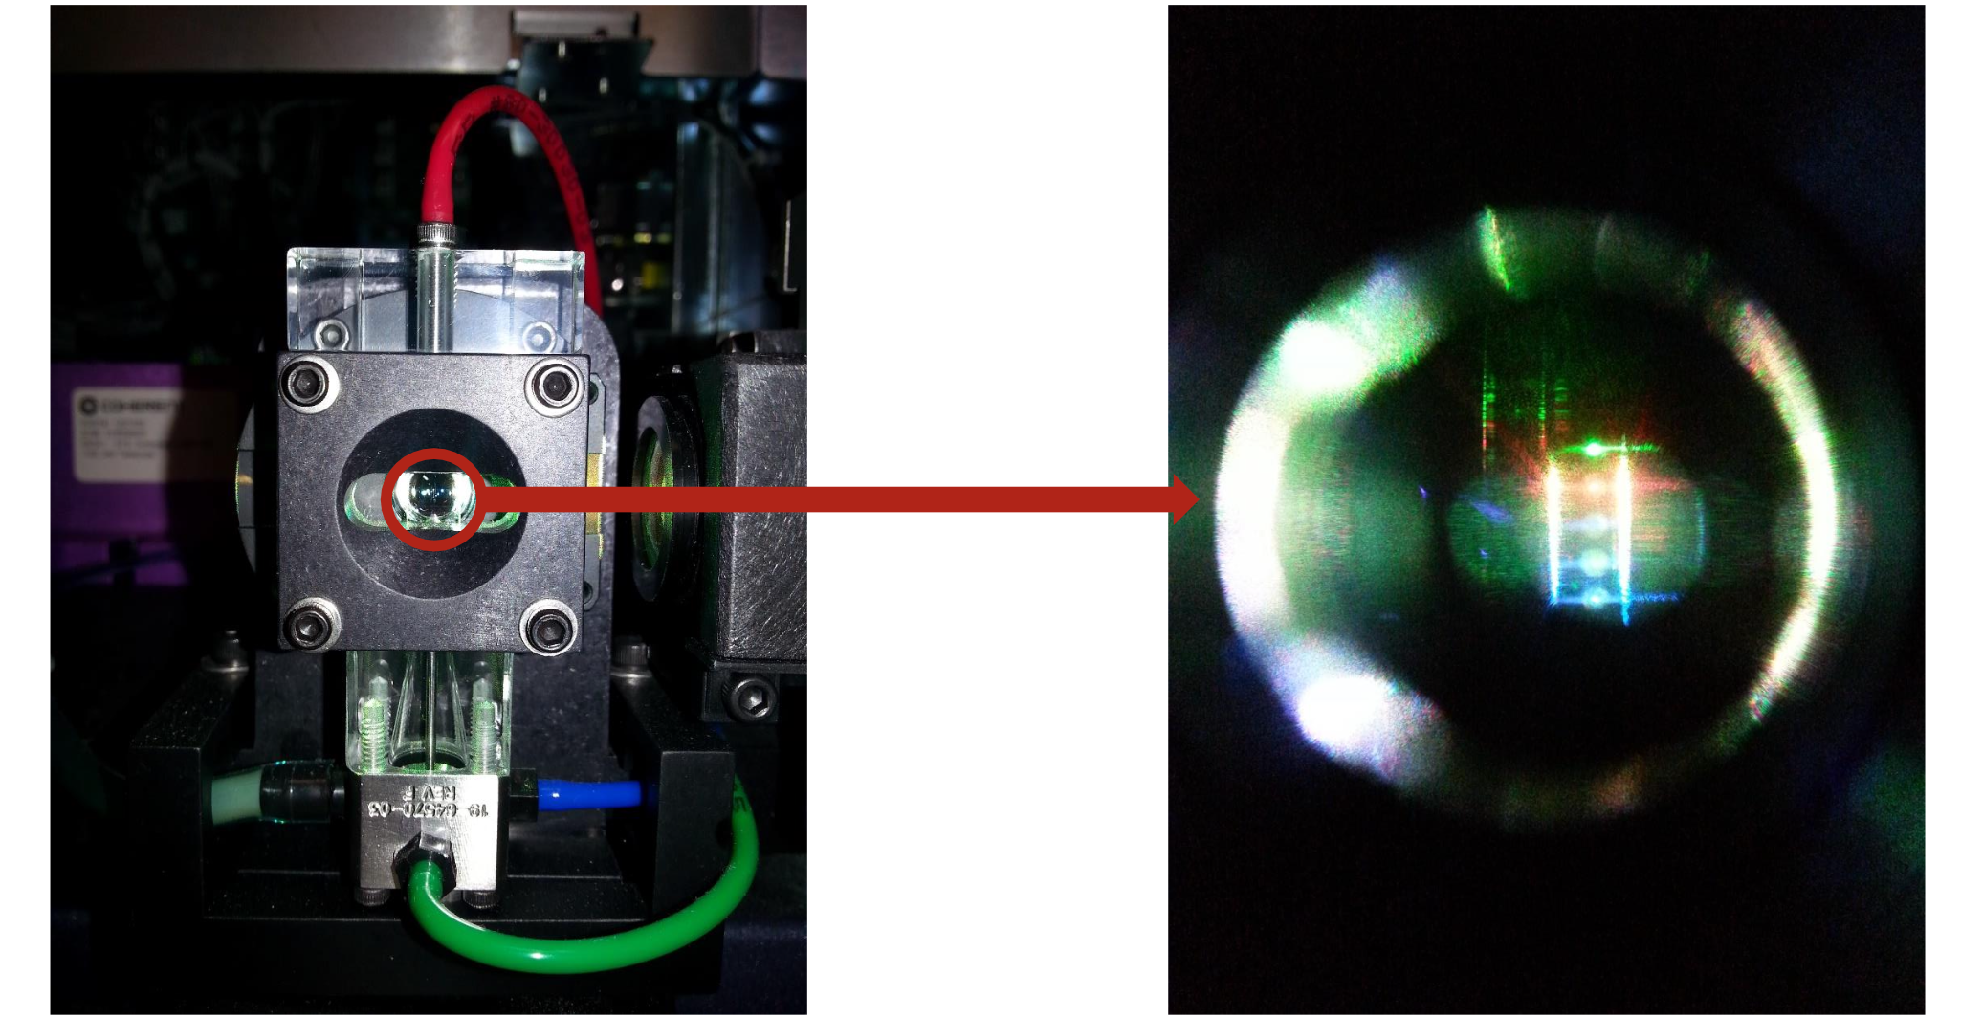
Flow Cytometry Background
The previous animation is simplistic, showing only one laser. Our sorters use 5 different colored lasers to interrogate cells as they go by.
Careful timing (laser delays) allows the software to recombine the data as if the cell encountered all the lasers at once, instead of sequentially.
Image of a flow cell from Aarika MacIntyre’s Presentation:
Introduction to Flow Cytometry

Slide 5
Flow Cytometry Background
When a fluorophore is excited by a laser, it emits the laser’s energy as light of a longer wavelength. This light is captured and quantified as data.
Gates based on the intensity of the fluorescent labels, cell size, and granularity, identify the desired cell population for sorting and analysis.
Gif taken from educational video by the StarCellBio Project @ MIT
http://star.mit.edu/CellBio/animations/index.html
Full video is available on YouTube

Slide 6


FACS: Fluorescence-Activated Cell Sorting
Here we wish to collect only red or green cells.
After interrogation by lasers, the cell stream passes through a narrow, vibrating nozzle that will cause it to break into droplets, each containing less than one cell (on average).
Just before the droplet containing the cell of interest breaks off, an electrode applies a specific charge to the stream. The droplet retains this charge as it falls.
These charged droplets pass between two deflection plates whose constant electric fields cause the droplets to deflect to the right or left.
  Uncharged droplets fall straight down into the waste bucket and are discarded.
  The sign and amount of charge on the drop determines how far the drop is deflected, allowing it to be caught in a specific tube or well.
Essentially, our sorters are either a Fortessa or an Aurora sitting on top of a droplet creating/deflecting device.
Electrode
Lasers
Flow Cell
Nozzle
Deflection
Plates

Slide 7
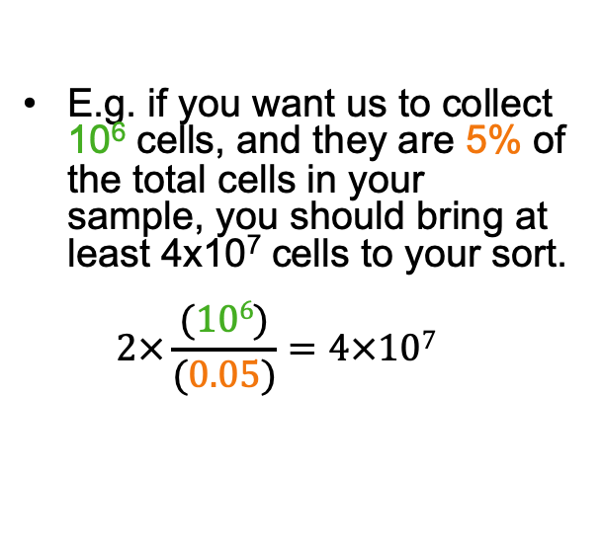
How Many Cells Should I Bring?
$$\text{\#}\text{Sample} \text{Cells}\text{= 2}×\frac{(\#Sorted Cells Wanted)}{(\% of Total Population)}$$
E.g. if you want us to collect 10⁶ cells, and they are 5% of the total cells in your sample, you should bring at least 4x10⁷ cells to your sort.
$\text{2}×\frac{(106)}{(0.05)}=4×107$
What affects my yield?
Electronic Aborts
  Too many cells trying to move through laser/detector at once are rejected.
Sorting Conflicts
  Target cell with followed by a non-target cell in the next droplet is rejected in purity mode. This gives a purer final result.
Cell death/adherence to plastic.
https://med.virginia.edu/flow-cytometry-facility/equipment/faqs-for-cell-sorting/
Notes:
You’d want to bring 40 million cells in a volume of 2mL or so.
We use a factor of 2 (50%) instead of theoretical 75%-90% for protection against bad luck (e.g. clogs) and to account for debris.

Slide 8
Sample and Collection Containers
Bring Your Samples in:
We can Sort into:
5mL FACS tubes
  Handy for filtering!
OR
15 mL tubes
  Aurora CS: must be Falcon brand
  (Or we’ll just transfer your sample into another tube type.)
OR
  1.5mL (or 2mL) Eppendorf tubes, but we’ll have to cut off the cap.
2 x 15mL tubes (any brand)
4 x 5mL FACS tubes
4 (Aria) or 6 (Aurora CS) x 1.5mL Eppendorf tubes
Plates:
  6 through 96 well
  Arias only: also 384 well
Standard Microscope slides.
Notes:
Aria can’t chill the sample tube, but Aurora can.

Slide 9
How Many Cells Should We Collect for You?
“As many as possible” is not a useful answer if we don’t have time to run 100% of all your samples.
  Should we divide the time evenly across the samples or skip some samples in order to get complete collections of the ones we can?
  If a sample does not contain more than XXX cells, should we skip it and run the rest of your samples? How many cells do you need for your assay?
  If we can collect more than XXX from your sample in the time allotted:
    Can you use them?
    Did you bring enough collection tubes/media?
  If we’re collecting common population (C) and a rare population (R), do you want the same number of cells for each? Or stop collecting C at set value and keep going until we hit our target for R? Or collect all the C’s and R’s even though C might be 100x as many as R?

Slide 10
Practical Considerations: Goals
Maximize Cell Viability before/during/after sort.
Maintain optimal Fluidics for best data/sorting quality/purity.
Optimize sorting Time (neither too fast nor too slow).
Optimize Data Quality.
Notes:
The next few tables are meant to be a checklist for your reference.

Slide 11
Practical Considerations: Before the Sort
Viability | Fluidics | Time | Data Quality
1mM HEPES in FACS buffer (stable pH) | Low serum (<3mM) | Remove cell debris (especially from skin, tumor, brain, liver, lung, etc.) | Titrate your antibodies. (Saves $$$ too!)
Optimal Sample temp. | Single cell suspension | Pre-enrich sample if possible | Optimize panel on an analyzer.
Minimize staining/handling times |  | Lyse/remove RBCs if present | Make single dye controls.
Don’t load 7-AAD until just before running. |  |  | Make gating controls.
 |  |  | (Plan to) use a viability dye.
Notes:
Points:
Viability:
Cell Media is basic in room air.
Not all cells like to be cold (or warm)
7-AAD is toxic, or at least it forces its way into living cells over time (which are then excluded). Since live cells don’t take it up so quickly, you’re getting the L/D snapshot right before sorting, and you’re taking the live cells away from the dye faster than if they sit in it from lab to here.
Fluidics:
Serum can do weird things to the fluidics.
Cells must be well suspended… clumps clog the machine, waste time, and sample.
Time:
Sort runs faster if a larger percent of the events are cells you want vs. debris you don’t.
Some debris can be sticky/make clogs.
Too much debris can obscure the cells you want. Back gating iteratively can help, but it’s easier when you can see clearly.
Data:
Titrate for best results (more later)
Optimize panel on an analyzer ahead of time:
CS = Aurora
Aria 5’s == Fortessa Assembly, LSR 15, LSR Assembly
Can also run pilot on sorter to set voltages/establish baseline compensation, optimize for the real experiment.
Single Dye Controls → Better compensation, more clarity
Gating Controls → Accurate results (more later)
Use a Viability dye because dead cells are different than live. (Sometimes take up more antibody too… could make you set your gate too high and miss the good stuff.)

Slide 12
Practical Considerations: During the Sort
Viability | Fluidics | Time | Data Quality
Collection media: Extra serum? Nutrients? Lysing buffer? | Nozzle choice | Speed of sort slower can mean more yield faster can get cells to next step earlier (less time to die) | Optimize gating strategy
Dilution of collection media by sheath droplets | FILTER your samples <30 min before running | Dilute samples will dramatically increase sort times. | If you want the FCS files, let us know how many events to record.
Temperature while waiting |  | Purity (default) vs. Yield | Periodically rerun single dye controls on subsequent sorts.
Temperature while being collected |  | Threshold: higher can be faster, but also ignores debris in collected sample. | If you want a purity check, let us know so we can budget time for it.
Notes:
Sheath is always room temp.
For a long sort, consider dividing sample into smaller portions so bulk of sample can sit on ice while smaller aliquot is being sorted.
Viability:
ALWAYS put some liquid in the tube.
Rare populations desiccate
Charged drops adhere to plastic
Cells die when they smack into the plastic
Cells need something to eat/keep them happy while they wait for the next step.
Account for dilution (more later)
“waiting” temperature
Whether in collection tube or on bench. We can chill the collection tubes during the sort upon request.
Fluidics
Nozzle Choice (more later)
Filter
Time
Make sure we have enough time to run your sort slower if needed. There’s a balance.
Overly dilute samples waste time
Default setting favors purity but we can sacrifice purity a little to give you a higher yield upon request.
We usually only raise the threshold when debris is a major issue. Anything below threshold is ignored/not preferentially removed or kept.
Data
A sensible gating strategy will give you better results (examples later)
We can record FCS files for you. Just let us know how many events you want to analyze.
You’ll get better results if you rerun your comps on later sorts (at least once in awhile).

Slide 13
Practical Considerations: After the Sort
Viability | Fluidics | Time | Data Quality
Temperature while waiting. | (It’s water under the bridge now.) | Minimize time between collection and next steps… especially if culturing or injecting. (batch process?) | Can request FCS files of sort to play with gating strategies for future sorts.
Consider batch processing for all day sorts? |  |  | Purity check
Notes:
Viabilty
Again, some cells like it cold, some don’t.
If we’re doing a multi-hour sort, consider processing your sample in batches?
Fluidics
Too late now…
Learn and Grow
Time
Minimize time between sort and next steps…
Data
Purity Check available upon request
Easy way to do A/B testing in addition to a record of your current sort.
Schedule more time for your sort for this so we can rinse out the machine for a clean read… especially if you have lots of tubes you want checked.

Slide 14
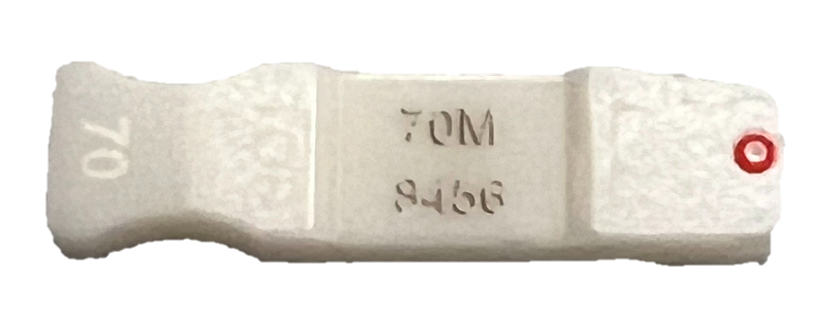

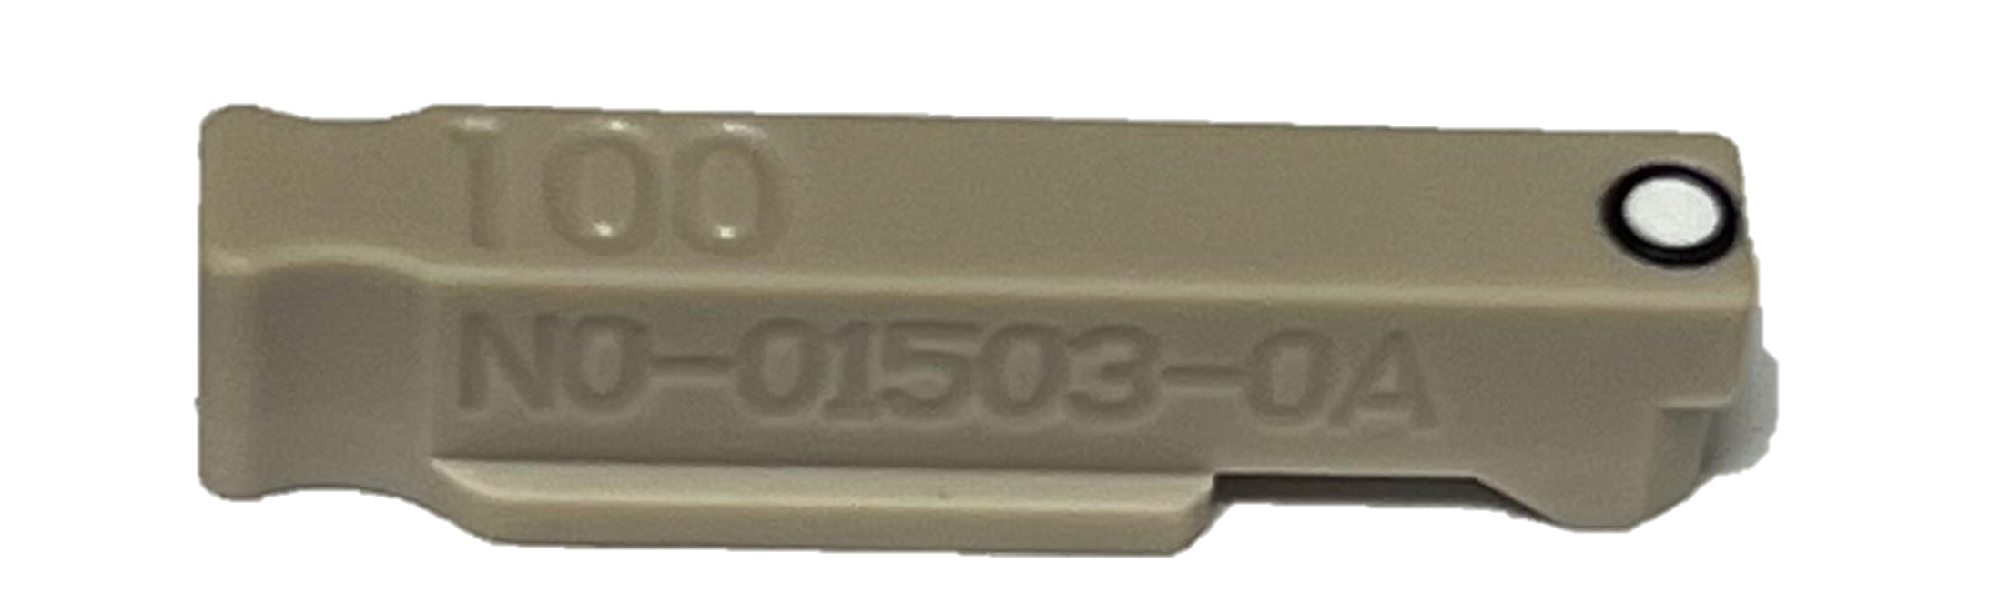
Practical Considerations: Nozzle Choice
Nozzle Size | Maximum Sort Speed (events/second) |  | Volume of 1000 Drops Collected | Relative Stress Level for Cells | Recommended Cell type
 | Aria | Aurora CS
70μm | 20,000 | 18,000 | 1.85μL | High | small/hardy (lymphocytes)
85μm | 10,000 | - | 3.4μL | Medium
100μm | 6,000 | 5,000 | 5.4μL | Low | larger/more fragile (macrophages)
Example nozzles for Aria (top) and Aurora CS (bottom).
Please note the tiny pin-hole (surrounded by the much larger red or black O-ring) that your sample is forced to go through at high pressure.
Notes:
As mentioned in the During the sort slide:
Nozzle choice affects time, viability, and fluidics.
Note also nozzle effect on volume of 1000 cells collected.
And stress.

Slide 15

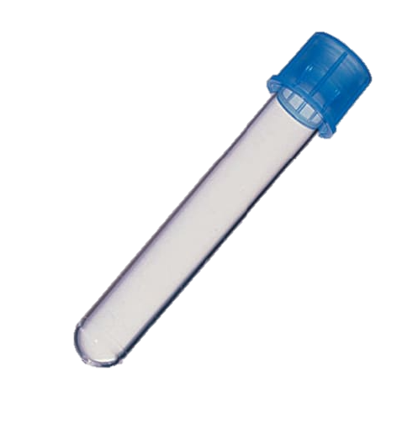
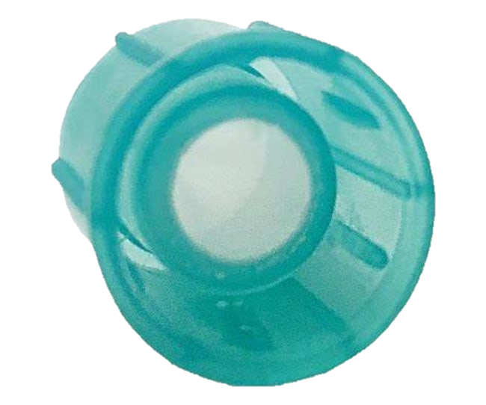
Why are we so insistent about filtering your samples?
Sorters clog more easily than the analyzers.
A clog will:
Waste precious sample and time as we work to clear it.
Increase the Biohazard Level of your sample by creating aerosols.
Risk contamination of your collected samples with unsorted cells.
  Often, the first sign of a clog is that the stream becomes unstable.
Aggregation is an ongoing process.
Your sample may need to be filtered again at the sorter, or even again part way through a long run.
Recommendations:
Filter your samples just before bringing them to us.
35μm mesh (blue or green) filter top FACS tubes work best for most applications.
The filter squares by the analyzers are 70μm. Use only if your cells are larger.
Purchasing options for filter top FACS tubes:
Falcon 352235 (FisherSci 08-771-23)
about $1.13 ea.
CellPro CT6405 (FisherSci 50-233-6003)
about $0.62 ea.
CellPro CT6409 (FisherSci 50-233-6067)
CAPS ONLY (Always filter into a NEW tube!)
about $0.41 ea.
Notes:
Some of you have purification protocols that call for even finer filtration.
We are happy with 35um for the purposes of not clogging the sorter. I.e. if we need to refilter during a sort, and you’ve already done your super fine filter during the prep, the 35um filter will work to keep the sorter happy.

Slide 16
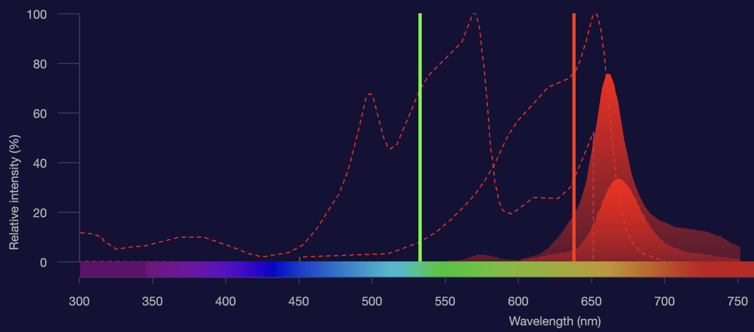
(Why) Do I Need Single Dye Controls?
Q: My panel uses colors that are excited by different lasers, why do I need single dye controls?
A: Sometimes a dye can be excited by more than one laser.
Example:
APC is excited by the red laser.
PE-Cy5 is excited by the green laser but can also be excited by the red.
When used with APC, which has a similar emission curve, there is significant overlap that will need to be compensated or unmixed.
PE-Cy5 (on left)
APC (on right)
Notes:
Image is normalized to red laser.
Also look at excitation of PE by 488. I.e., mention how adding green laser excited fluors will be confounded by PE.
More examples:
PE-Cy5 & APC
DAPI (UV and Violet)

Slide 17
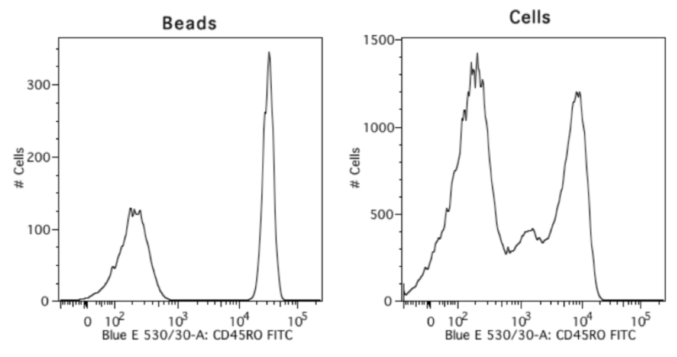
(Why) Do I Need Single Dye Controls?
I don’t have enough sample for them!
Good news! You can use antibody capture beads for most of your colors!
These beads bind to antibodies and make a nice bright signal for us to set voltages and run compensation with.
Don’t forget to include a negative bead population in each control.
As nice as beads are, you should always use cells for your unstained and live/dead single dye controls. The Aurora CS also requires that you use cells for the unstained control.
This positive population is
too rare!
Use beads instead!
Upper Figure from: Cheeky Scientist
Notes:
Some brands of beads provide positive and negative beads in separate vials.

Slide 18
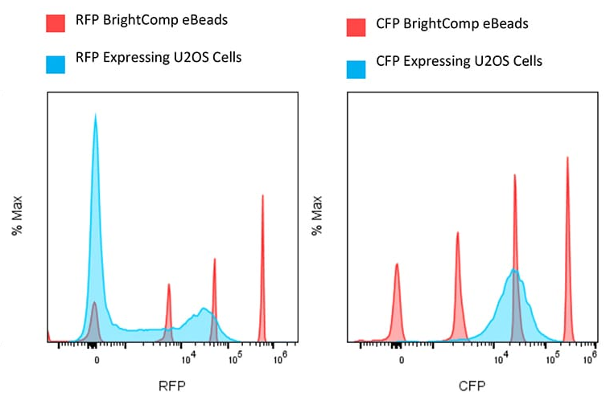
But I’m using reporter genes in my cells:
I don’t have an antibody I can use, now what?
Good news again!
They also make compensation beads that are already bound to your favorite reporter fluorophores like mCherry, GFP, RFP, YFP, CFP, …
This brand includes a negative peak and 3 positive peaks. Just gate on the peak that’s slightly brighter than your sample.
Figure from: ThermoFisher
Notes:
I.e. if you sample is the blue set, then adjust voltage to get it on scale. Run peaks, and gate on best representative.
(This is so you can do analysis work with them yourself. If you bring us the beads, we can work with them.)

Slide 19
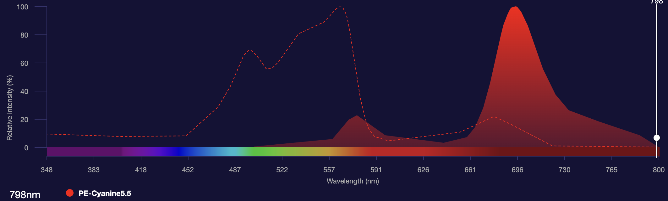
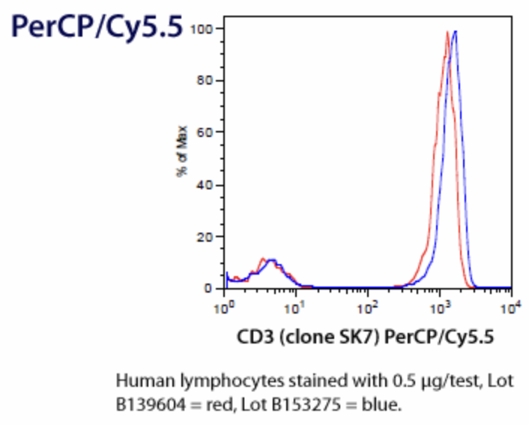
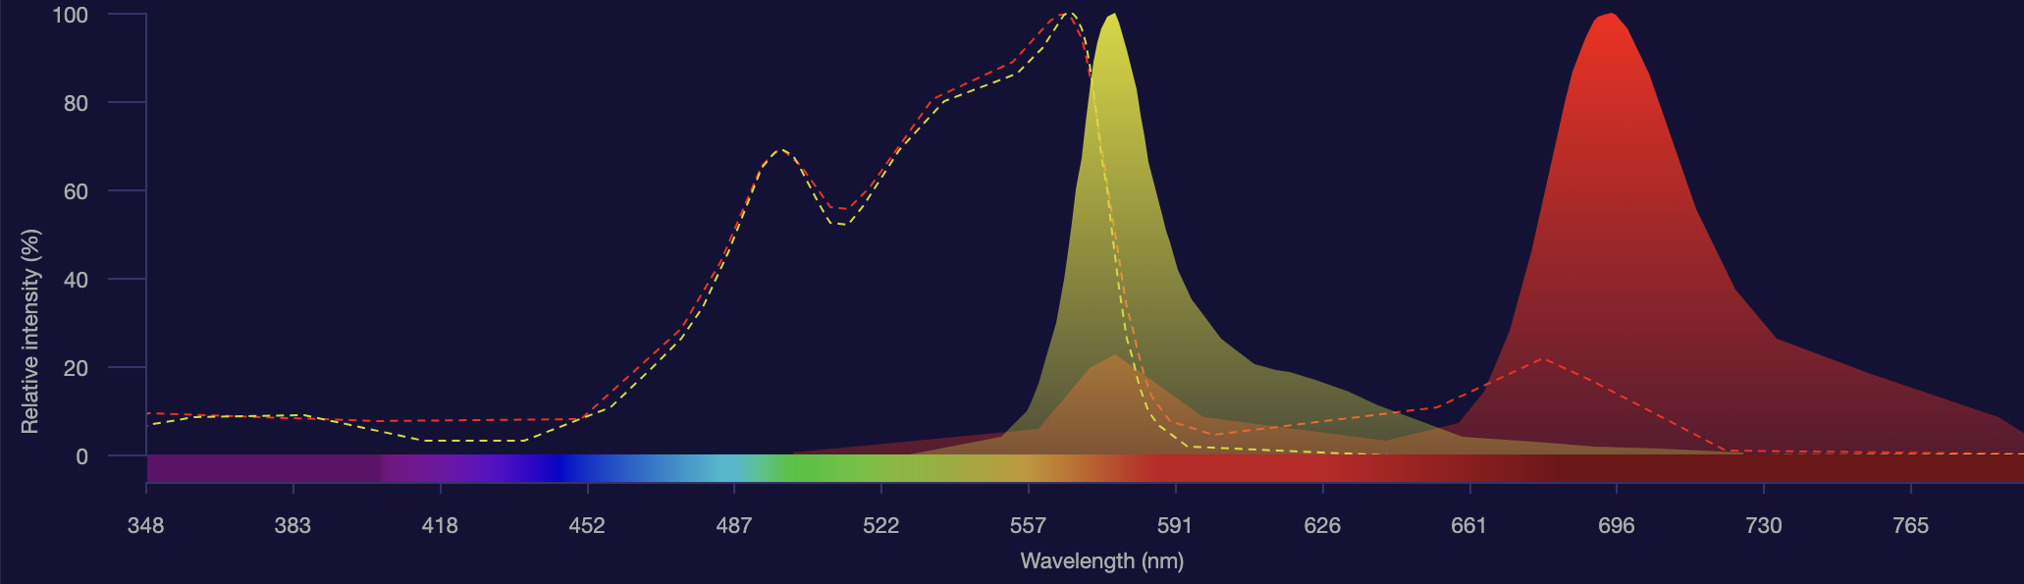
(Why) Do I Need Single Dye Controls AGAIN?
Can’t I use my old compensation matrix?
For a little while, you might get away with using the old compensation (or unmixing) matrix to sort your cells.
But if any of the following occurs, you would be wise to rerun your single dye controls:
A laser is replaced on the machine (they don’t last forever).
A different lot of tandem fluorescent antibody is used.
Something bad happened to your current antibody stock. (E.g., your PI left it on the bench overnight instead of putting it away… again.)
A color is added to the panel. This includes that reporter gene you don’t intend to gate on. You still need to comp it.
It’s been more than a month or two. Lasers age, tandem antibodies degrade, machine maintenance happens.
You change cell lines or tissue types (even though you’re using the same panel, autofluorescence matters!).
You’re just not sure.
PE-Cy5.5
Lot to Lot Variability
Tandem Fluorophore Degradation
PE and PE-Cy5.5
Fig from Biolegend
Notes:
Give examples of tandem dyes:

Slide 20
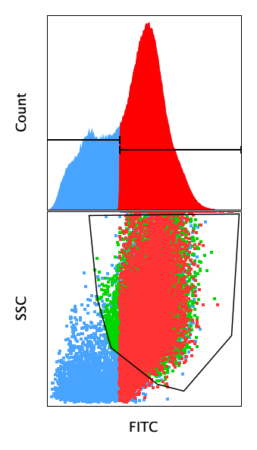
Why should I gate in 2D if there’s only a 1 color? Why not use a 1D histogram?
A gate drawn in a 1D histogram may be fine if the parent cell population is homogenous.
  E.g., a transfected cell line (assuming transfection doesn’t affect morphology).
Use scatter on Y–axis of dot plot if parent cell population has more than one type of cell.
  Green cells are FITC+ gate from 2D dot plot.
  Red cells are FITC+ gate from 1D histogram.
Notes:
Below 10³ is just where we tend to put the negative population from the SDC when setting voltages… we could just as easily use 10², (but have less separation).
Point out
green NOT red (false negative)
red NOT green regions (false positive)
Green+Red is a display issue I couldn’t figure out in Flowjo (same for Red+Blue and Green+Blue)

Slide 21
Why would I need controls if there’s only one color???
While it’s true your cells don’t need to be compensated or unmixed, it’s still valuable to bring both positive and negative controls (especially to your first sort).
Without a negative control, where is the best place to set the gate to collect the positive population?
  What if your positive population is a very small percentage of the total cells?
  What if it’s usually X% positive, but this time it’s actually Y% positive?
Notes:
(I’ve already gated in FSC vs SSC to get the cells we want to sort, and I’ve gated for singlets…)

Slide 22
Why would I need controls if there’s only one color???
Sometimes contours show boundaries between populations, sometimes not.
  Be careful! In Diva, once you draw a gate, the software colors those contours separately, and will artificially exaggerate the distinction between the two populations.

Slide 23
Why would I need controls if there’s only one color???
Sometimes 1D histograms show boundaries between populations, sometimes not.

Slide 24
Why would I need controls if there’s only one color???
(Negative Population)
The accepted method is to provide the same cells without the positive population.
  This may mean untransfected cells, or it may mean cells transfected with an empty vector.
  Also, notice that there is nothing magical about the number 10³.
  If there’s more than one color in your panel, an FMO is the best choice (see next slide).
Notes:
Below 10³ is just where we tend to put the negative population from the SDC when setting voltages… we could just as easily use 10², (but have less separation).

Slide 25
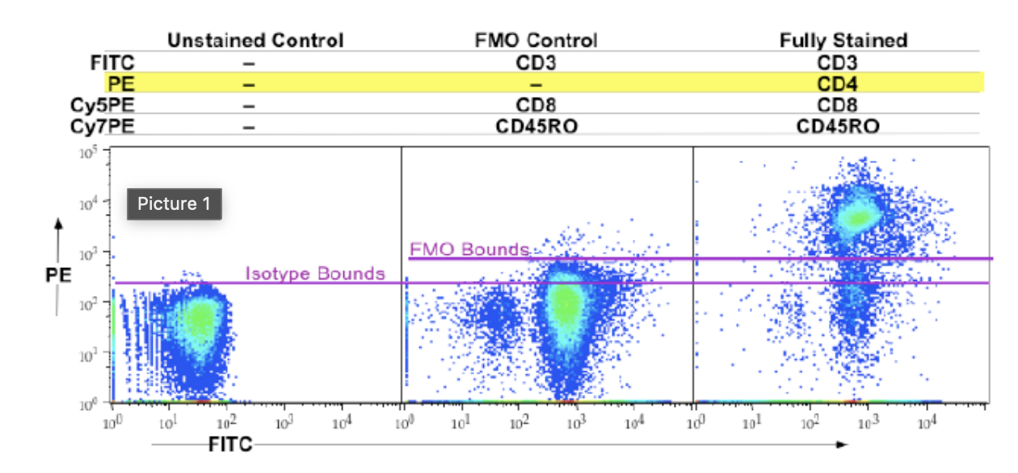
Why might I want to use an FMO control?
Isn’t unstained just as good?
FMO = Fluorescence Minus One = Your full color panel, minus one color (the one you’re gating on).
Figure from: Daily Dongle
Notes:
And if you have a very rare population, this will only increase your confidence in the purity/accuracy/sensitivity of your assay by avoiding false positives.
If you have CD4 or CD8, you almost never need an FMO…. FMO’s are for smeary populations.

Slide 26
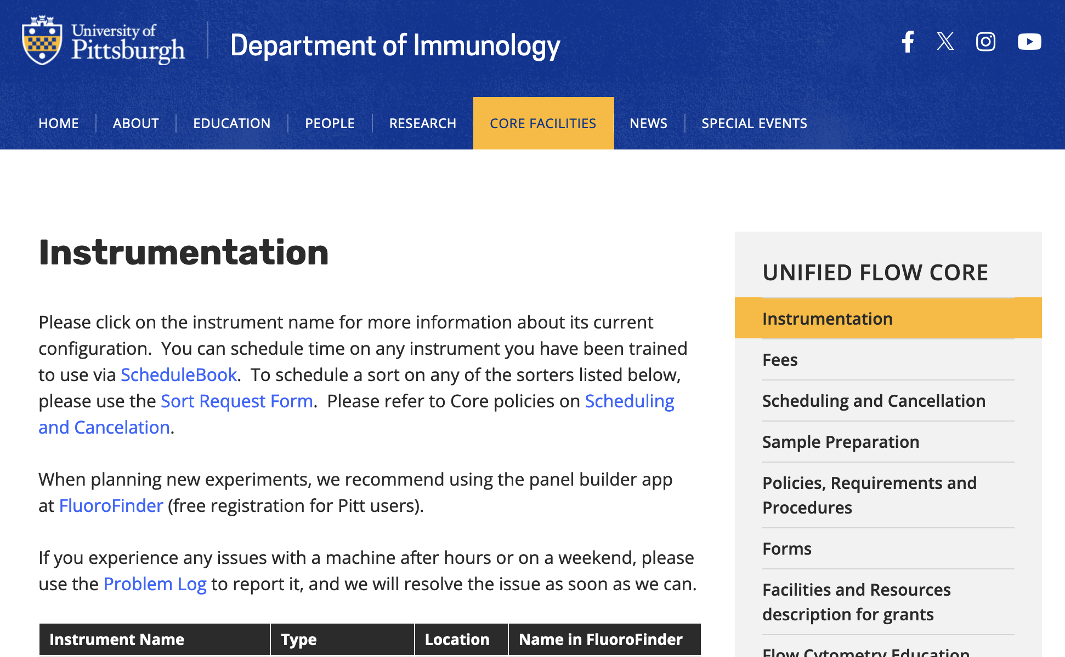
Why can’t I use the same panel on the same kind of sorter? Aren’t they all the same?
No. These machines were customized with different lasers and default filter configurations by the people who originally bought them.
  E.g., the Aria Assembly 5 laser has 5 Violet channels, whereas the other two Arias have 3 Violet channels.
  E.g., the Aria Assembly 5 laser has a yellow-green laser (561nm) instead of a green laser (532nm).
And our sorters may be configured differently than the one your collaborator is using in another facility…
Etc…
https://www.immunology.pitt.edu/core-facilities/ufc/instrumentation

Slide 27
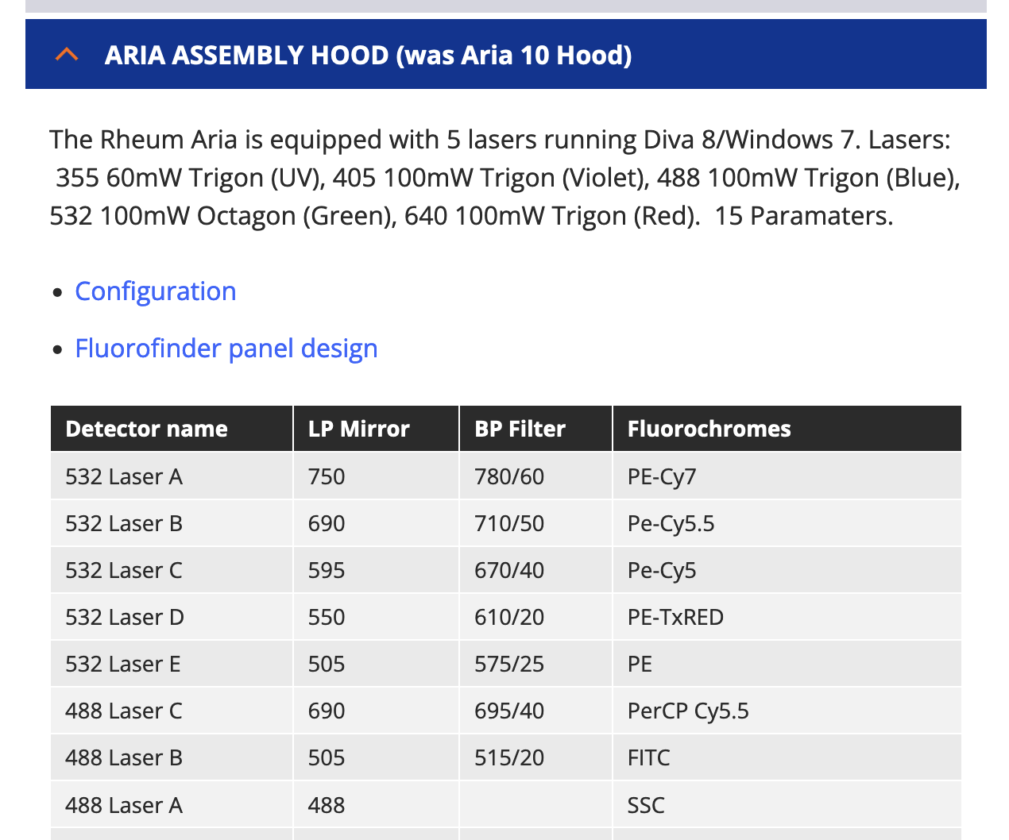
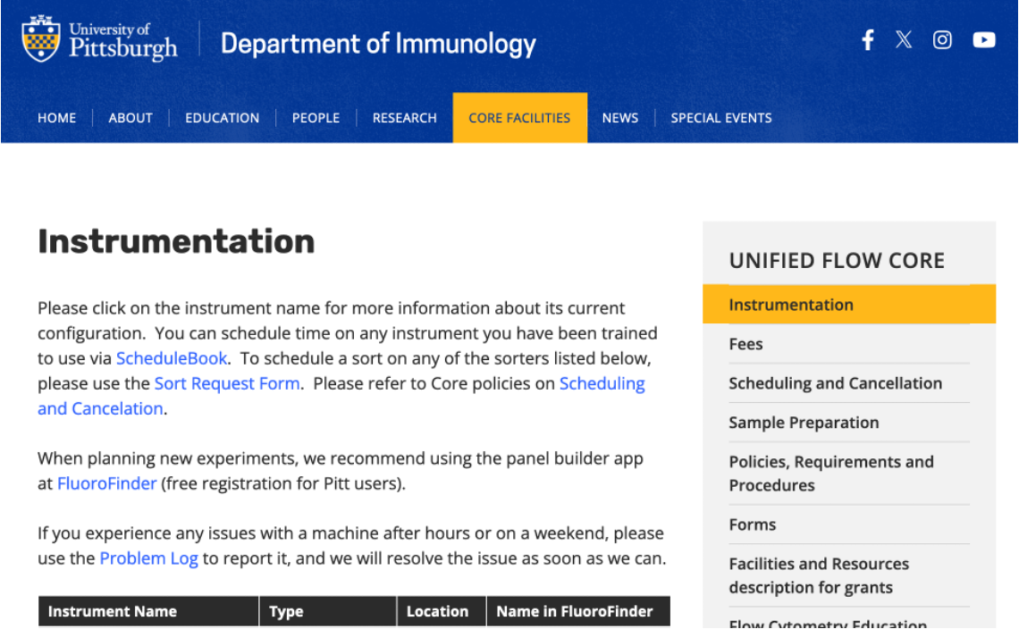
2 ways to find the Default Configuration for both Sorters and Analyzers
Flow Core Website Instrumentation Page
With helpful links!
Laser Wavelength = excitation wavelength
Letter = specific PMT (detector) for this row
Default BP (band pass) filter = emission wavelength
e.g. “780/60” = 60nm band centered on 780nm = 750nm to 810nm is detected
Example Fluorochromes =
Name of channel on cytometer
(True for analyzers too!)
Notes:
E.g. 4 options for a given laser = that’s the max number of colors that we can detect on that laser.

Slide 28
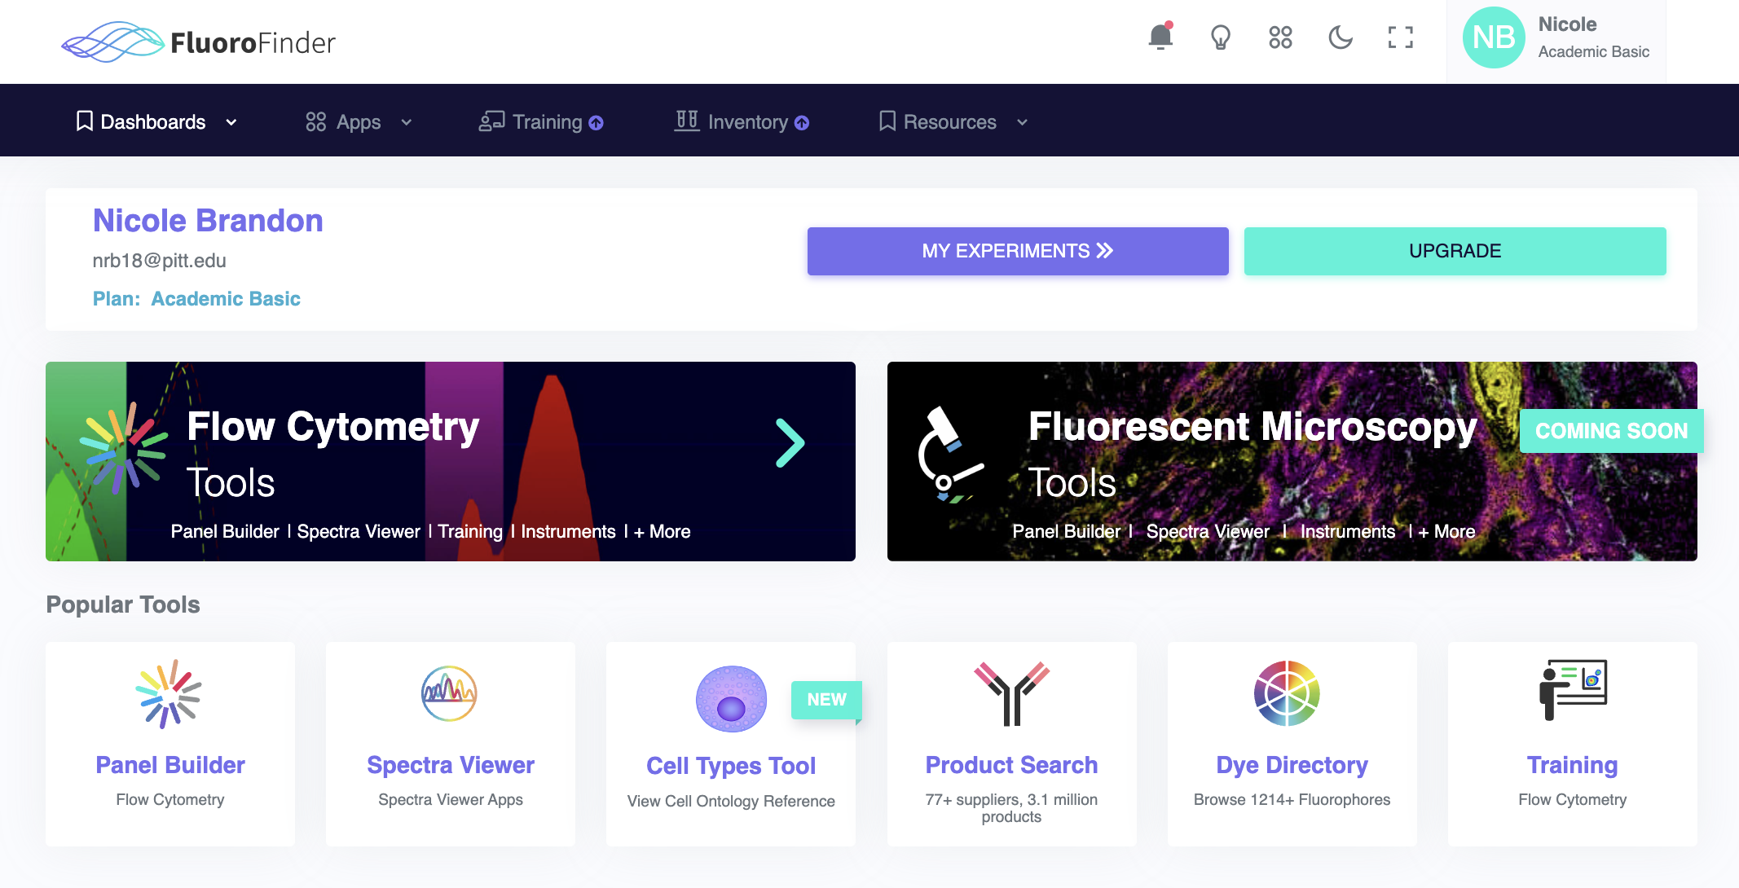
2 ways to find the Default Configuration for both Sorters and Analyzers
Flow Core Website – Instrumentation Page
FluoroFinder
  You have a free basic academic account as member of Pitt. (ignore menu options with this symbol: )
Set your Institution and Facility in your profile to save time.
YN
Your Name
Your Name
your_email@pitt.edu
Plan: Academic Basic
➔
Notes:
Just click on your name in upper right part of the screen to get the drop-down menu to select “My Account.”

Slide 29
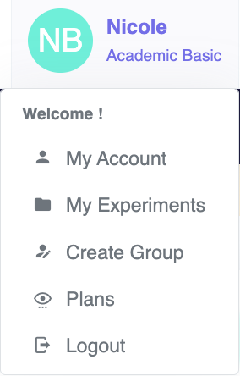
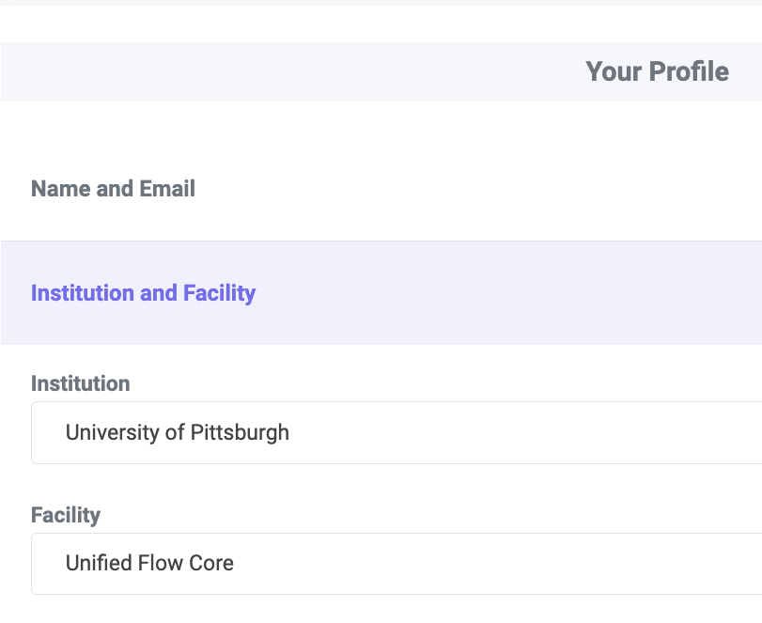
2 ways to find the Default Configuration for both Sorters and Analyzers
Flow Core Website – Instrumentation Page
FluoroFinder
  You have a free basic academic account as member of Pitt. (ignore menu options with this symbol: )
Set your Institution and Facility in your profile to save time.
YN
Your Name
➔

Slide 30

2 ways to find the Default Configuration for both Sorters and Analyzers
Flow Core Website – Instrumentation Page
FluoroFinder
  You have a free basic academic account as member of Pitt. (ignore menu options with this symbol: )
YN
Your Name
Your Name
your_email@pitt.edu
Plan: Academic Basic
➔
Notes:
Just click on your name in upper right part of the screen to get the drop-down menu to select “My Account.”

Slide 31
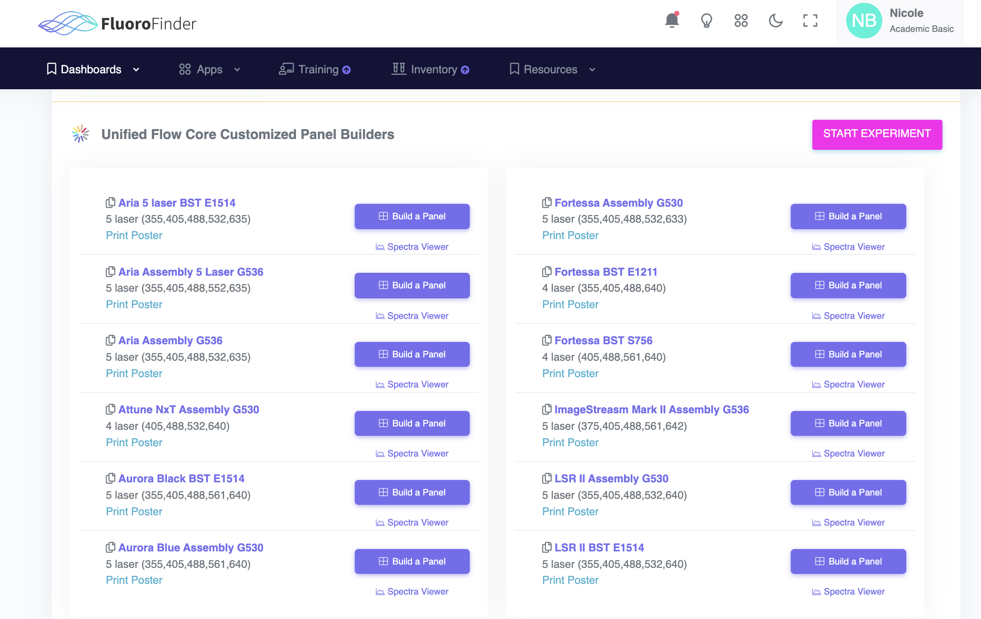
2 ways to find the Default Configuration for both Sorters and Analyzers
Flow Core Website – Instrumentation Page
FluoroFinder
  You have a free basic academic account as member of Pitt. (ignore menu options with this symbol: )
➔

Slide 32
When should I use the Aurora CS
Instead of an Aria?
Use the Aurora CS when you:
Have more than 8-10 colors in your panel.
  You can test and refine your panel on an Aurora Analyzer, and it will also work on the CS.
Need a 6-way sort (into 1.5mL tubes).
Need to resolve two colors that are too similar to each other on the Aria.
Have a gating scheme that goes deeper than 8 layers.
Simply want to.
But remember:
Single dye controls are REQUIRED.
  These controls MUST MATCH the fluorophore used in the sample. Please ask if unsure.
An unstained CELL control is REQUIRED.
  Unstained beads do NOT work for this purpose.
If you’re bringing your sample in a 15mL tube, please use FALCON brand only. Otherwise, we may need to transfer your sample to another tube.
Notes:
Don’t NEED a reason to use the CS, but sometimes you have to.
Unstained CELLS required for autofluorescence correction.

Slide 33
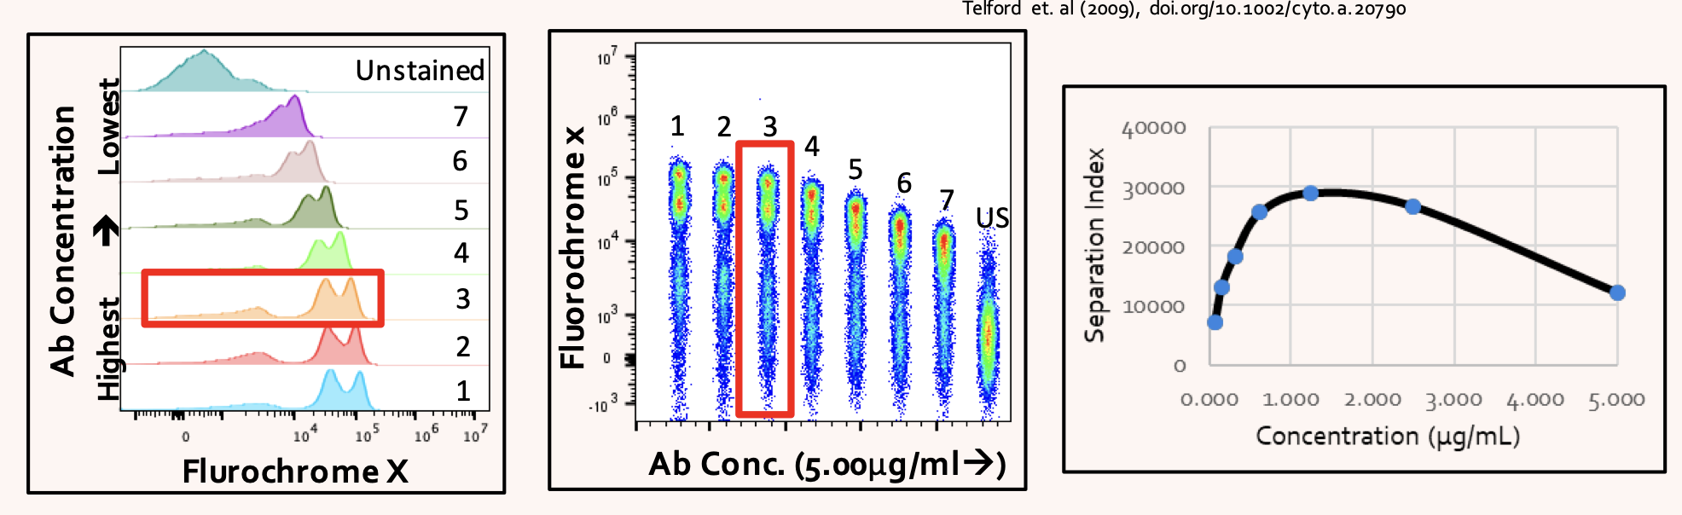
Why would I want to titrate my antibody?
Get the best possible resolution.
Antibodies are expensive, you might not need as much as you think.
Too much antibody leads to non-specific staining and WORSE resolution.
Can test on an analyzer well before the sort.
3
2
4
5
6
1
7
https://wi.mit.edu/sites/default/files/2021-05/20200420_Post-it_Titration_Final.pdf

Slide 34
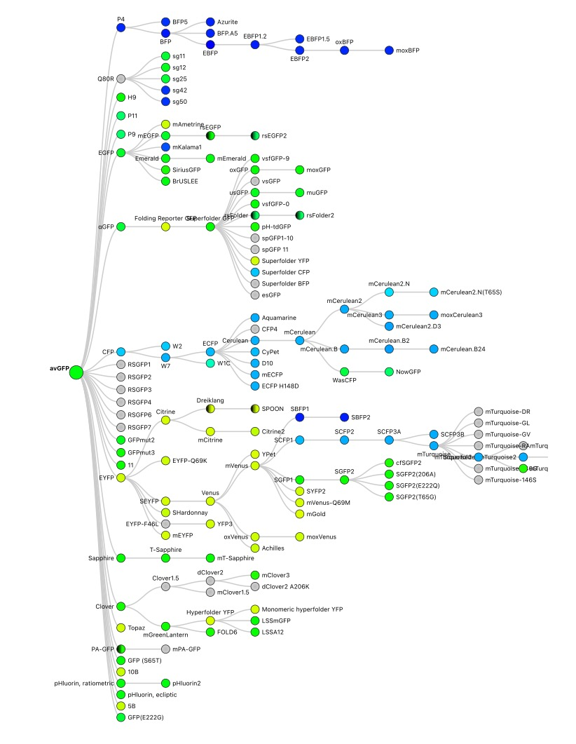
I already told you!
My panel is using CD3, green, and CD8-blue…
Not to be too pedantic, but…
CD3 is a cell marker, not a color.
There are entire FAMILIES of different colored markers descending from a green fluorescent protein, whose structure was solved in 1992. Also true for other common fluorophores.
When we know which SPECIFIC fluorophore (or fluorochrome or fluorescent protein) that your panel is using for each marker, we can set the machines up correctly for you before you get here.
Fluorochrome specificity is 10,000 times more important for spectral sorting on the Cytek Aurora CS.
GFP
(Fluorophores derived from GFP… so far.)
Figure from FP Base
Notes:
Don’t try to read the dyes… it’s just showing you that Ghengis Khan and GFP both sired a lot of offspring.
Even pruning out BFP, CFP, and YFP descendants of GFP leaves a LOT of green…
And is green the color of the excitation laser or the color you see under a microscope or ???
Lots of Zombies out there too.

Slide 35
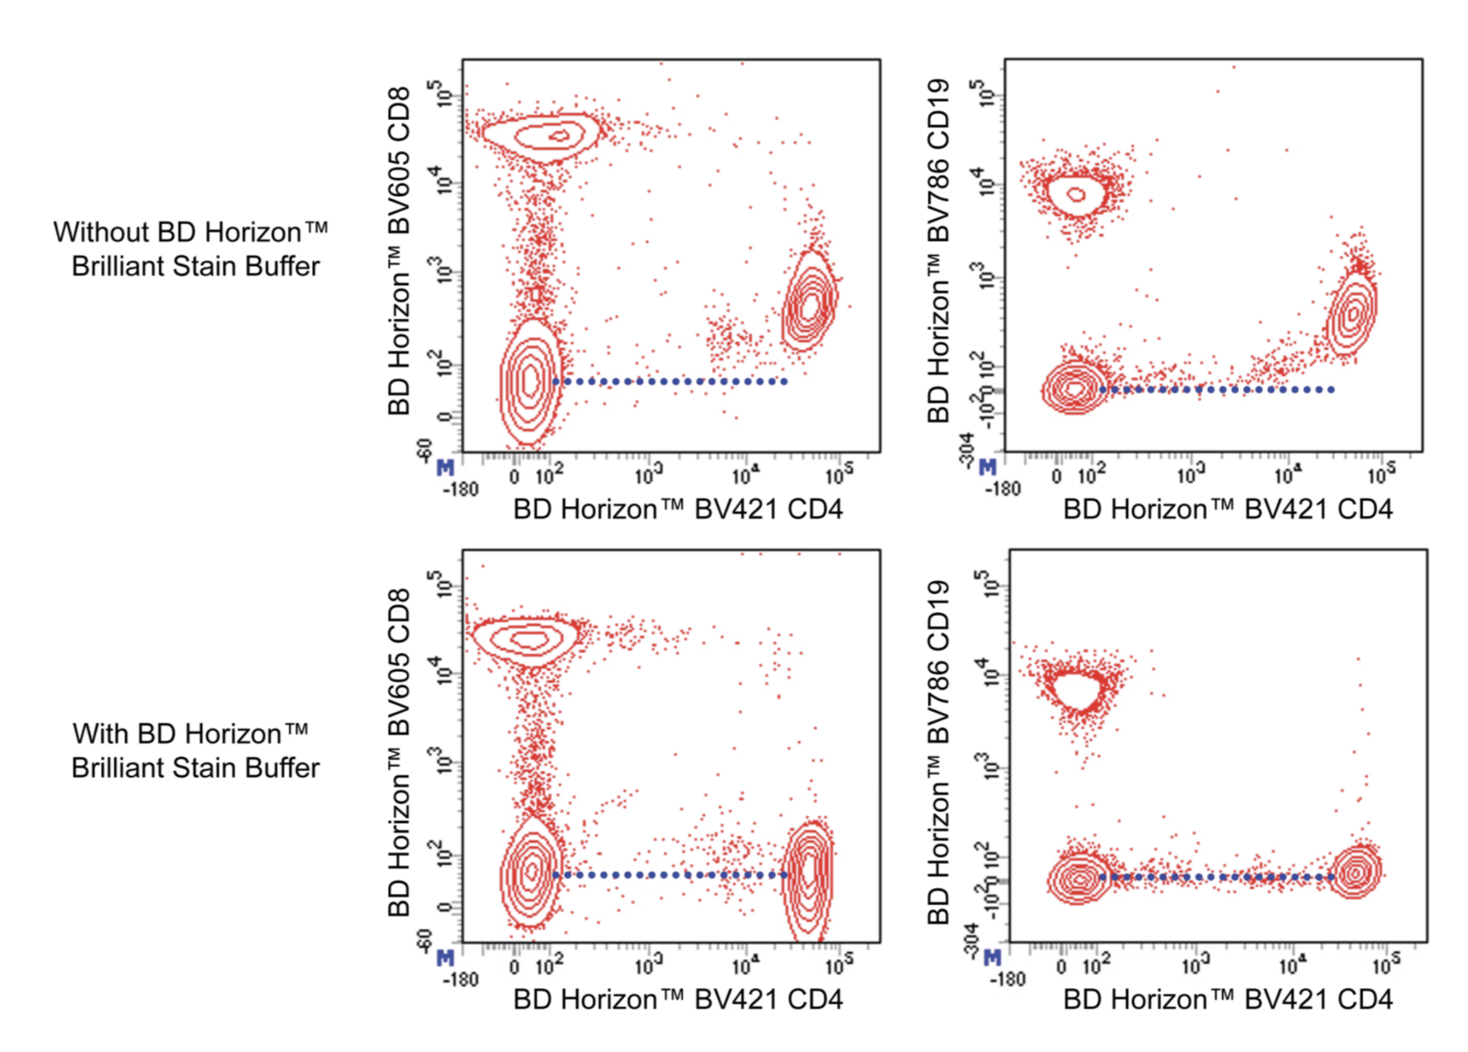
What is Weird about Brilliant Fluorophores?
Brilliant UV, Brilliant Violet, Brilliant Blue, etc. are all polymer dyes.
When using more than one color from the Brilliant ___ family in your panel, be sure to add Brilliant Buffer to your staining mix so they don’t stick to each other.
Without
Brilliant Buffer
With
Brilliant Buffer
Figure from BD Biosciences

Slide 36
Oops!
My sample is too dilute
Problem:
Your sample will take longer than necessary to sort. Which means:
  We may not be able to finish your sample in the time you booked.
  Your cells are away from ideal culturing or assay conditions for longer than necessary (i.e., they’re changing and dying).
How to Remedy
If your sample is very dilute, we can run an aliquot of it while you take the rest back, spin it down, and resuspend it in the recommended (smaller) volume.
  This process will require refiltering after you resuspend the pellet.
Next Time
Resuspend in less volume.
  20 million cells/mL is a good starting point.
  Diluting a sample with sterile sheath (PBS) is quick and easy to do at the machine…. Or you can bring your favorite buffer for this purpose.
Notes:
Otherwise, we’ll sort as much as we can in the time available.
You can always COUNT your cells…

Slide 37
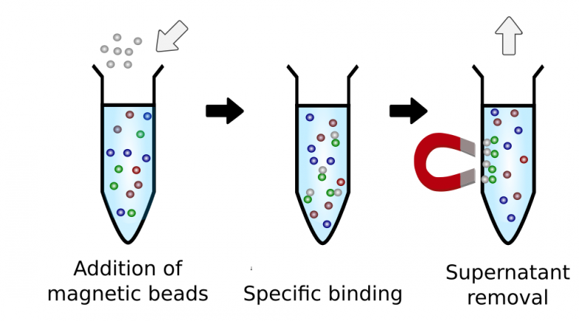
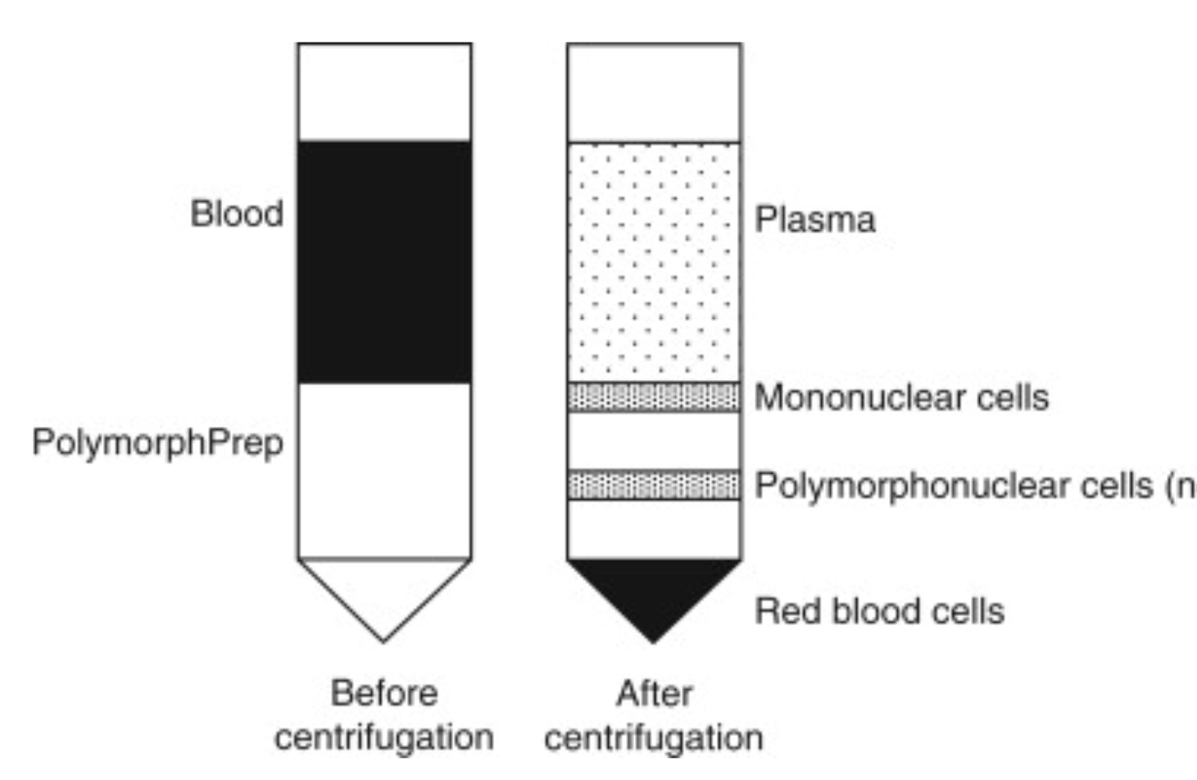
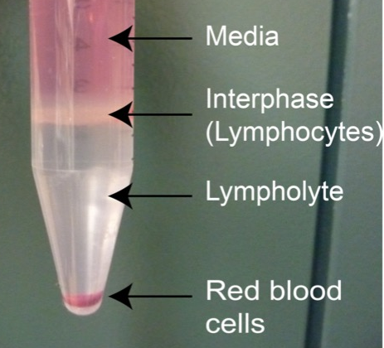
Oops!
Desired Cell Population is too Rare
Problem:
1 cell in 1 000 000 events takes a long time to get through.
  That’s at least 50 sec per cell at top speed, and you need us to collect how many cells???
Two Ways to Remedy:
Pre-enrich your sample population with negative selection (use magnetic beads with antibodies to bind cells you DON’T want).
Remove debris via density media such as Lympholyte, Lymphoprep, Percol, Ficol, etc… Works on homogenized tissue too, not just blood.
Ready to Sort
Digested Tissue
Density Media
(e.g,. Lympholyte)
Figures from Antibodies Online and Science Direct
Notes:
There are also mechanical separators out there to try: e.g., SepMate™ from StemCell Technologies (LMK if you try it/like it)
Raising threshold sorta helps, by distributing smaller debris amongst your collected samples.
Top figure (point out that there are no green cells left in last step)

Slide 38


Why Use a Dump Channel?
You can’t go more that 8 gates deep on an Aria.
All Events = 0th level.
P8 will sort, P9 will not.
Get around this by using the Aurora CS, or by using a “Dump Channel”
  Dump Channel – assign the markers you want to EXCLUDE (or dump) to the same color.
All Events
P1
P2
P3
P4
P5
P6
P7
P8
P9

Slide 39
How to Select a Sorter Based on
BioSafety Level
If you’re unsure, please ask before scheduling the appointment.
Aria Assembly 5-Laser
(no hood)
Non-infectious
Aria Assembly Hood
Cell Culture
Aria 15 &
Aurora CS
(Hood)
BSL2+ or lower
Aseptic
RNA work
Cell Assays
Sterile
Non-hazardous
Non-hazardous
Sterile
Non-infectious
(no BSL2)
The biosafety level for a pathogen may be increased by the aerosolization that occurs during sorting. (Cytometry A. 2022 May; 101(5): 380–386)
If you are using anything infectious or BSL2 (or higher), please discuss it with us WHEN SCHEDULING or PLANNING your experiment.

Slide 40
Oops, I’m Running Behind Schedule!
Communicate with us!
Send a runner or email to flowcore@pitt.edu with your estimated time of arrival (ETA).
Try for a Partial Start if possible.
Send runner with single dye controls, gating controls, or first few samples to get started.
Modify Workflow for Next Time.
We can help with ideas!
Understand that empty time on the calendar is often not empty for us (training, core paperwork/business, etc…).
Don’t assume you can run past your scheduled time or be rescheduled to later in the day. We will do our best to accommodate you,
Notes:
Master mix is not just a time saver, it will give you more accurate/consistent results sample to sample.
You are charged for the full time, even if you’re late.
Communicate!
Let us know what’s happening, and what your expected arrival time is.
Partial Start
Can you send a runner with your single dye and/or gating controls while you finish staining?
Can you bring the first couple of samples for us to run while the rest are finishing up?
Adapt
Has this come up before? Maybe we can give you some ideas to change the workflow so you can get started on time.
Use a master antibody mix.
Use comp beads where appropriate. Can prep them the day before if you like. (Prep your cell controls the same day.)
Get an assistant to help you.
Do a practice run, especially if a new, complex, expensive, rare, LONG, or very delicate prep is planned.
Be realistic
If you can’t make 9:30am, don’t schedule to start at 9:30am.
Don’t prep more samples than you can handle. This may mean you need to do shorter sorts over more days?
If you have a 2 hour sort and only 1 hour is available on the day you want to sort, you’ll need to either scale back, schedule on a different machine, or different day.
Understand
We will try to finish your sort as best we can in the time available.
But don’t assume that we are idle if there is open sorter time after you on the schedule (we may be training, doing machine maintenance, grabbing lunch, covering scheduling gaps, running analysis, etc.)

Slide 41
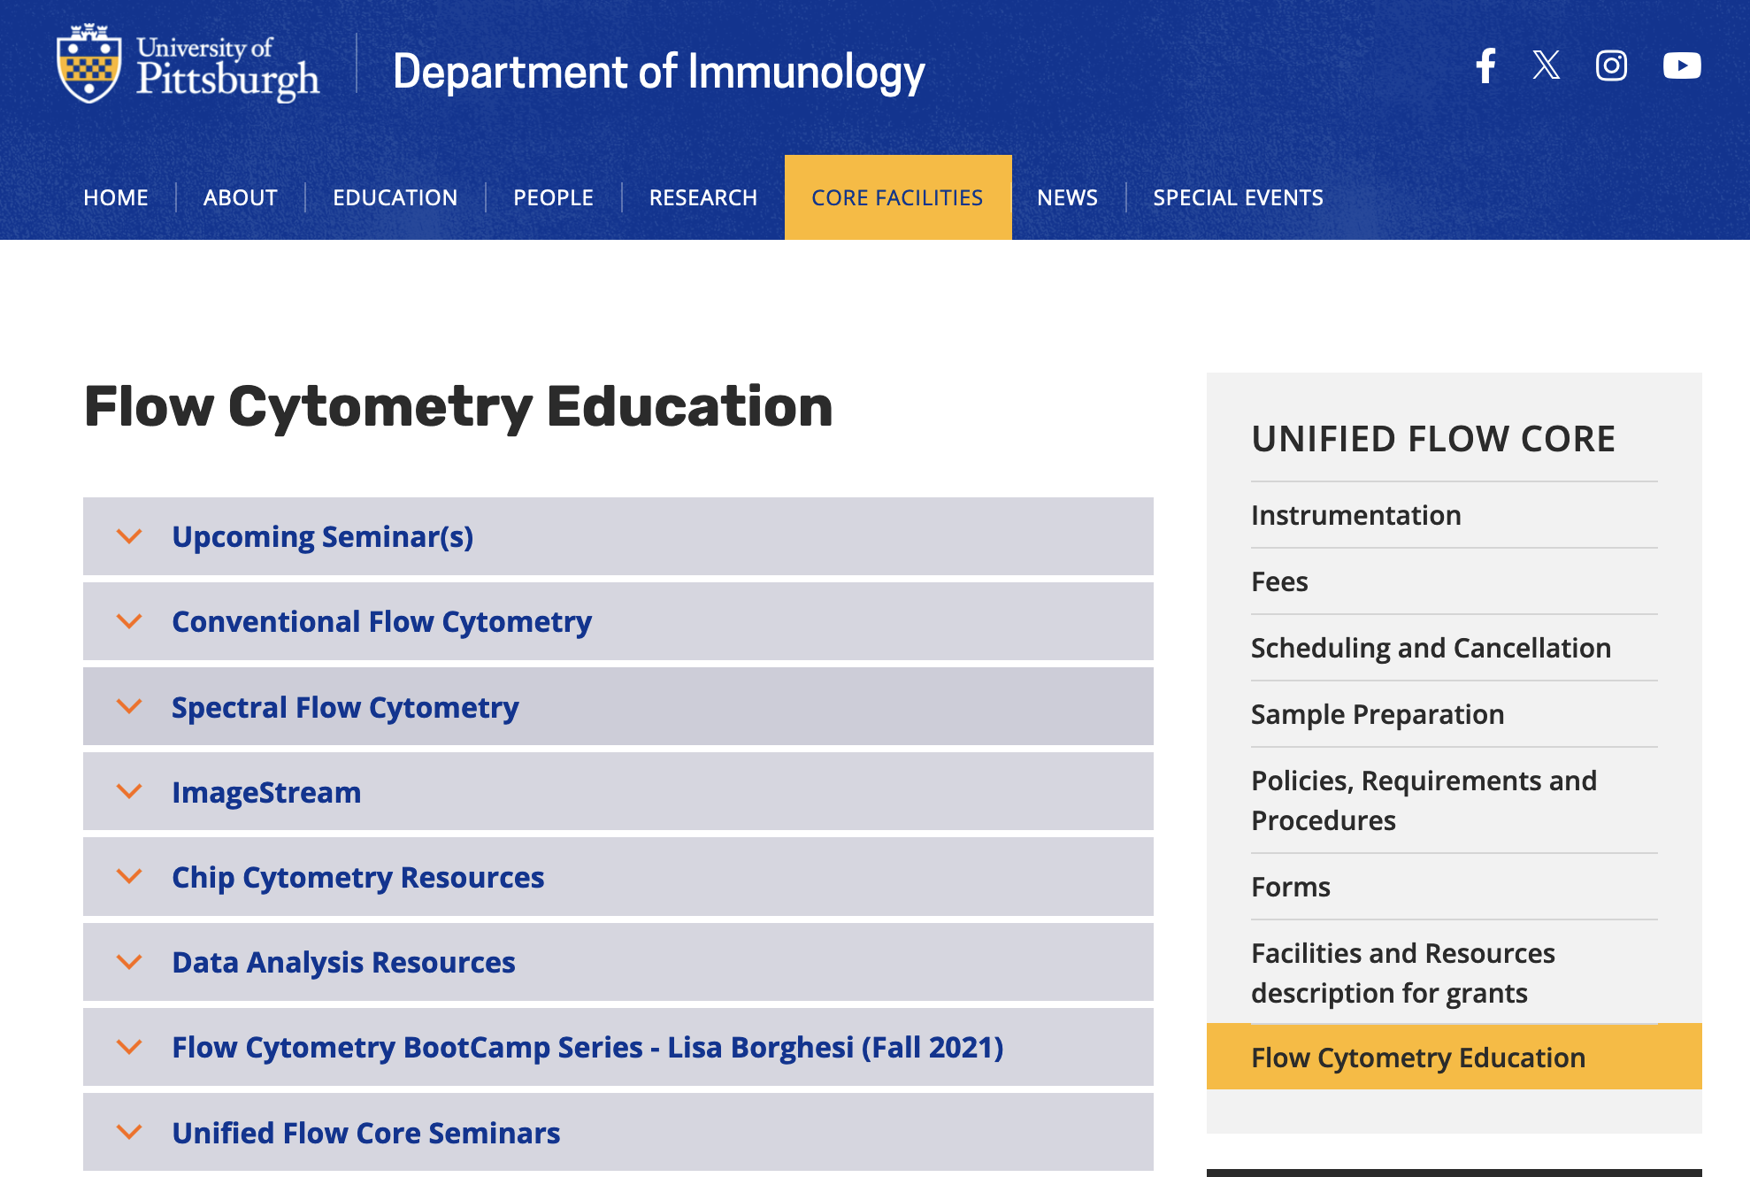
Thank you for Attending!
The Flow Cytometry Education Page has this and other seminars from the Unified Flow Core.
https://www.immunology.pitt.edu/core-facilities/ufc/flow-cytometry-education
We’re here to help!
  flowcore@pitt.edu
Notes:
Please make an appointment for more complex discussions/questions.

