Slide 1
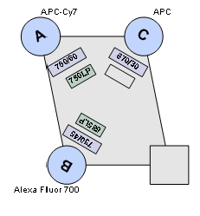
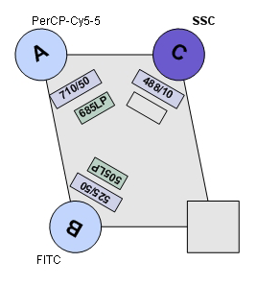
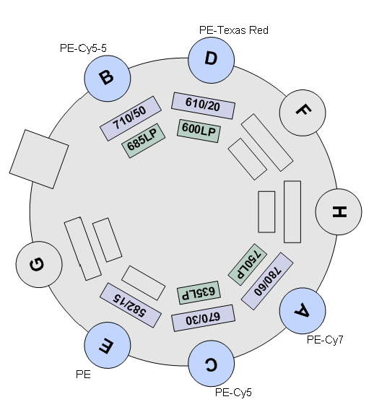
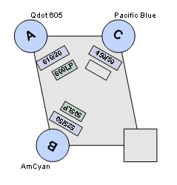
STI Fortessa
Red
Laser
640nm
Blue
Laser
488nm
Yellow-Green
Laser
561nm
Violet
Laser
405nm
530/30

